Slide 1

Neuroinformatics Lecture (L5)
Prof. Dr. Gordon Pipa
Institute of Cognitive Science, University of Osnabrück
Notes:
Hallo and thank you for the introduction.
I will present a non-parametric significance test for estimating the statistical significance of Joint-Spike events.

Slide 2
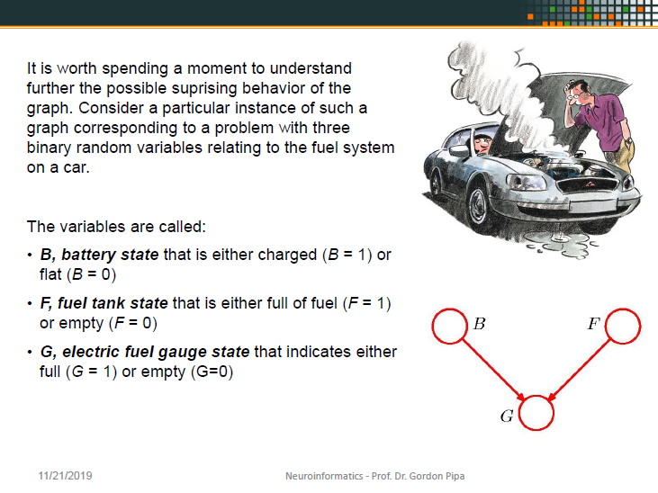
OLD

Slide 3

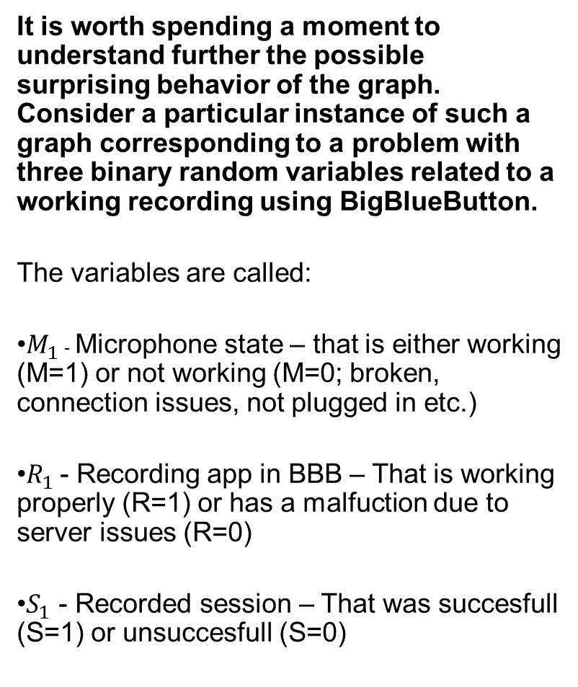
It is worth spending a moment to understand further the possible surprising behavior of the graph. Consider a particular instance of such a graph corresponding to a problem with three binary random variables related to a working recording using BigBlueButton.
The variables are called:
$M_{1}$ - Microphone state – that is either working (M=1) or not working (M=0; broken, connection issues, not plugged in etc.)
$R_{1}$ - Recording app in BBB – That is working properly (R=1) or has a malfuction due to server issues (R=0)
$S_{1}$ - Recorded session – That was succesfull (S=1) or unsuccesfull (S=0)
M
R
S

Slide 4
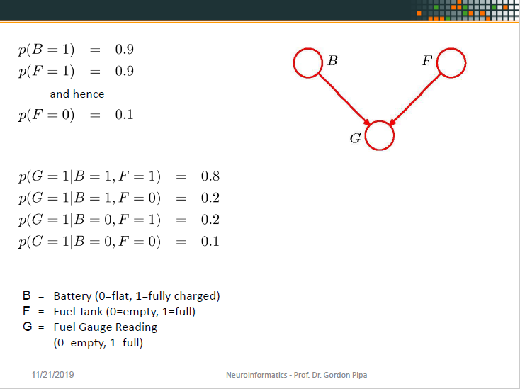
OLD

Slide 5
P(M=1)=0,9
P(M=0)=0,1
P(R=1)=0,9
P(R=0)=0,1
M
R
P(R=1) | P(R=0)
0,9 | 0,1
P(M=1) | P(M=0)
0,9 | 0,1
S
M | R | P(S=1) | P(S=0)
0 | 0 | 0,1 | 0,9
1 | 0 | 0,2 | 0,8
0 | 1 | 0,2 | 0,8
1 | 1 | 0,8 | 0,2
P(S=1|M=1,R=1)=0,8
P(S=1|M=1,R=0)=0,2
P(S=1|M=0,R=1)=0,2
P(S=1|M=0,R=0)=0,1
P(S=0|M=1,R=1)=0,2
P(S=0|M=1,R=0)=0,8
P(S=0|M=0,R=1)=0,8
P(S=0|M=0,R=0)=0,9

Slide 6
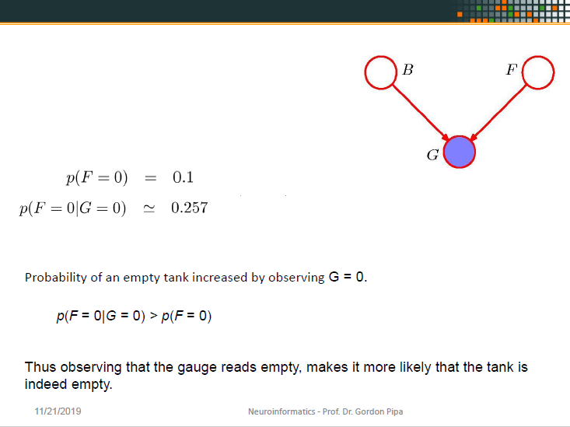
OLD

Slide 7
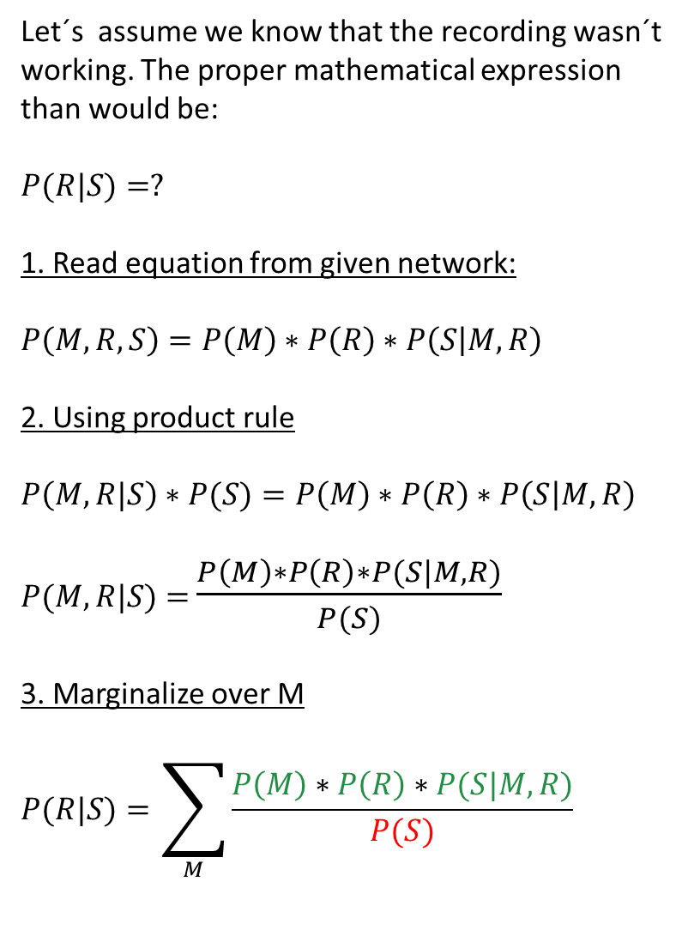
Let´s assume we know that the recording wasn´t working. The proper mathematical expression than would be:
$$P(R|S)=?$$
1. Read equation from given network:
$$P\left(M,R,S\right)=P\left(M\right)∗P\left(R\right)∗P\left(S | M,R\right)$$
2. Using product rule
$$P\left(M,R|S\right)∗P(S)=P\left(M\right)∗P\left(R\right)∗P\left(S | M,R\right)$$
$P(M,R|S)$ $=$ $\frac{P\left(M\right)∗P\left(R\right)∗P(S|M,R)}{P(S)}$
3. Marginalize over M
$$P(R|S)=\sum_{M}{\frac{P\left(M\right)∗P\left(R\right)∗P(S|M,R)}{P(S)}}$$
M
R
=
S
As we see on the tables a slide ago, there is no P(S) that we could directly plug in, as it is not directly given (dependend on p(M) and p(R)).
So we have to calculate it somehow out of the given information.

Slide 8
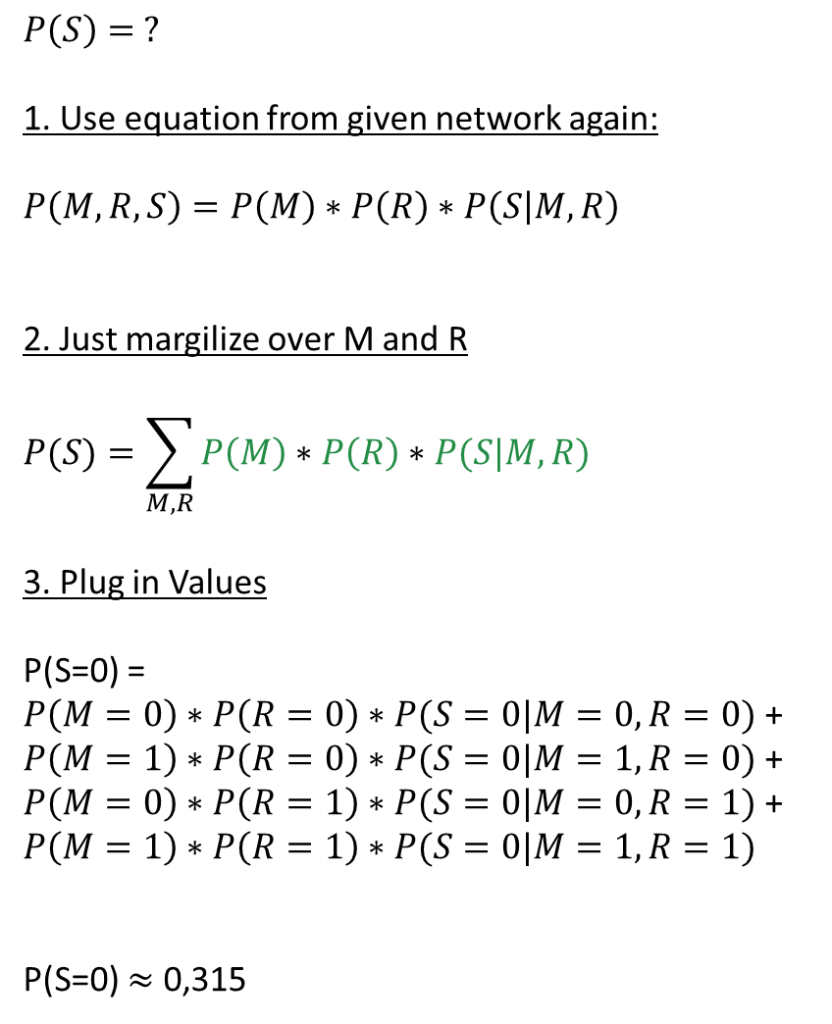
$$P\left(S\right)= ?$$
1. Use equation from given network again:
$$P\left(M,R,S\right)=P\left(M\right)∗P\left(R\right)∗P\left(S | M,R\right)$$
2. Just margilize over M and R
$$P(S)=\sum_{M,R}{P\left(M\right)∗P\left(R\right)∗P(S|M,R)}$$
3. Plug in Values
P(S=0) = $P\left(M=0\right)∗P\left(R=0\right)∗P(S=0|M=0,R=0)$ + $P\left(M=1\right)∗P\left(R=0\right)∗P(S=0|M=1,R=0)$ + $P\left(M=0\right)∗P\left(R=1\right)∗P(S=0|M=0,R=1)$ + $$P\left(M=1\right)∗P\left(R=1\right)∗P(S=0|M=1,R=1)$$
P(S=0) $≈$ 0,315
M
R
=
S
Now that we calculated our P(S=0) we can return to our original task.
As side nodes: You don´t need to calculate P(S=0) already here. You simply can plug the formula in later.
Additionaly we just calculated the probability of an unsuccesfull recording without knowing anything about the recording functionality or the state of the microphone given the probabilities on the table ☺

Slide 9
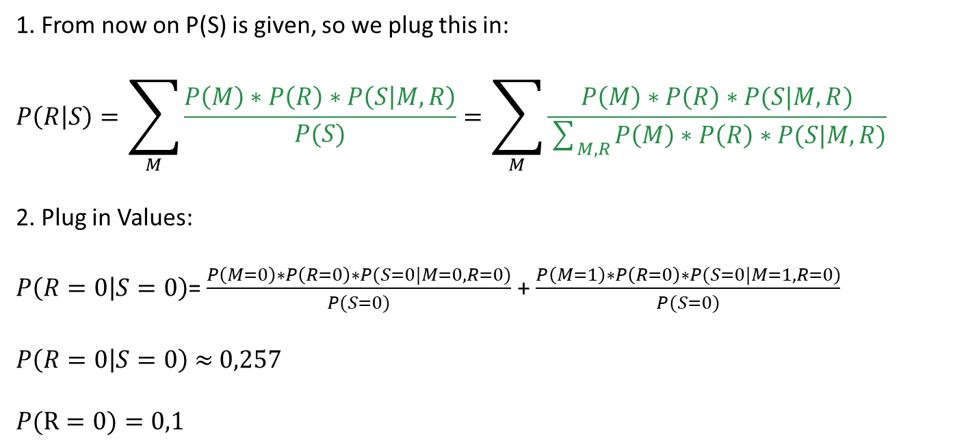
1. From now on P(S) is given, so we plug this in:
$$P\left(R | S\right)=\sum_{M}{\frac{P\left(M\right)∗P\left(R\right)∗P\left(S | M,R\right)}{P(S)}}=\sum_{M}{\frac{P\left(M\right)∗P\left(R\right)∗P(S|M,R)}{\sum_{M,R}{P\left(M\right)∗P\left(R\right)∗P(S|M,R)}}}$$
2. Plug in Values:
$P\left(R=0 | S=0\right)$= $\frac{P\left(M=0\right)∗P\left(R=0\right)∗P(S=0|M=0,R=0)}{P(S=0)}$ +$\frac{P\left(M=1\right)∗P\left(R=0\right)∗P(S=0|M=1,R=0)}{P(S=0)}$
$P\left(R=0 | S=0\right)$ $≈$ $0,257$
$$P(R=0)=0,1$$
Probability of problems with the recording function (B) increased by observing S = 0
p(R = 0|S = 0) > p(R = 0)
Thus knowing that the recording wasn´t successful, makes it more likely that the recording functionality wasn´t working properly. -> Simply common sense displayed in a mathematical manner.

Slide 10
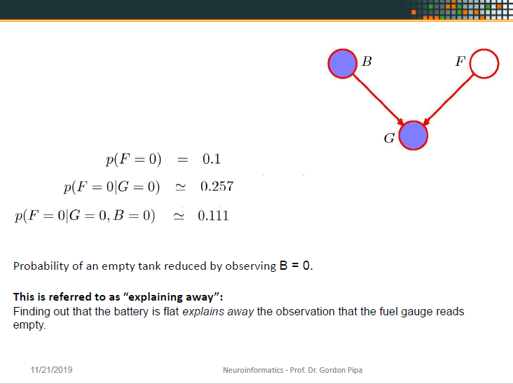
OLD

Slide 11
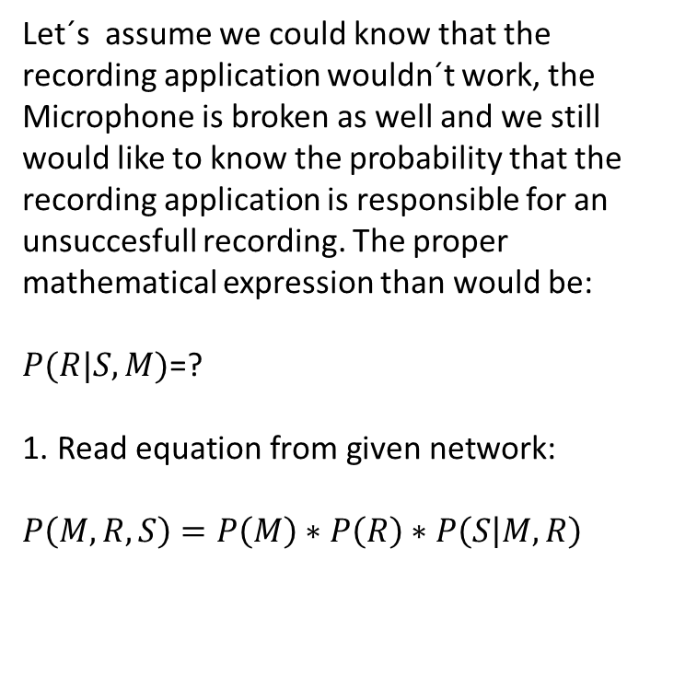
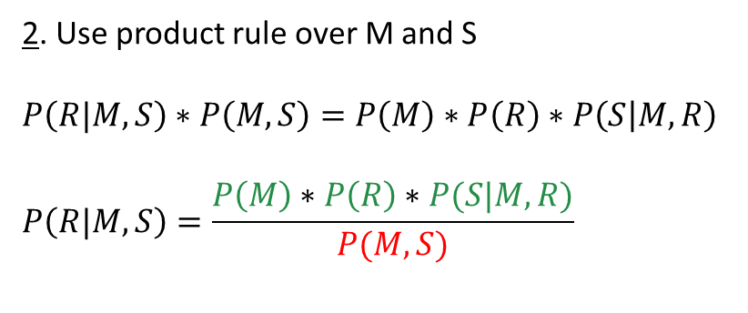
Let´s assume we could know that the recording application wouldn´t work, the Microphone is broken as well and we still would like to know the probability that the recording application is responsible for an unsuccesfull recording. The proper mathematical expression than would be:
$P(R|S,M)$=?
$$\text{1}\text{. }\text{Read} \text{equation} \text{from} \text{given} \text{network}\text{:}$$
$$P\left(M,R,S\right)=P\left(M\right)∗P\left(R\right)∗P\left(S | M,R\right)$$
M
R
S
=
As we see on the tables a slide ago, there is no P(M,S) that we could directly plug in, as it is not directly given (dependend on p(M) and p(R)).
So we have to calculate it somehow out of the given information again ;).
2. Use product rule over M and S
$$P\left(R|M,S\right)∗P\left(M,S\right)=P\left(M\right)∗P\left(R\right)∗P\left(S | M,R\right)$$
$$P\left(R|M,S\right)=\frac{P\left(M\right)∗P\left(R\right)∗P(S|M,R)}{P(M,S)}$$

Slide 12
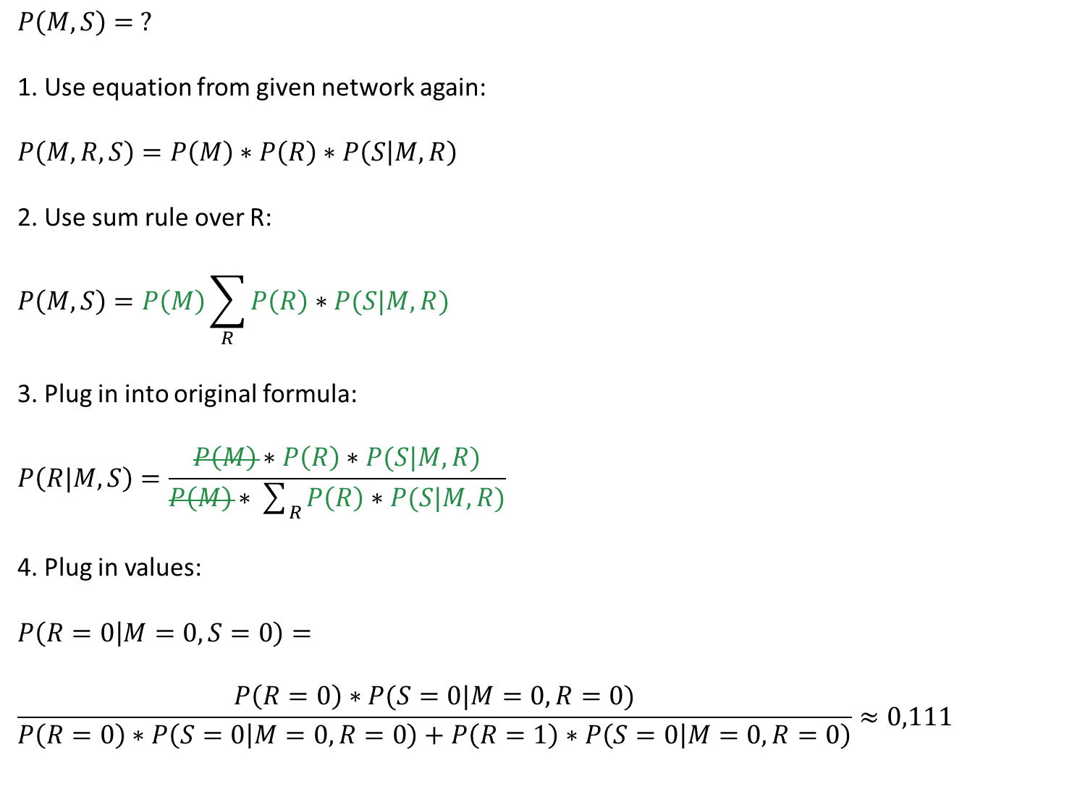
$$P\left(M,S\right)= ?$$
1. Use equation from given network again:
$$P\left(M,R,S\right)=P\left(M\right)∗P\left(R\right)∗P\left(S | M,R\right)$$
2. Use sum rule over R:
$$P\left(M,S\right)=P\left(M\right)\sum_{R}{P\left(R\right)∗P(S|M,R)}$$
3. Plug in into original formula:
$$P\left(R|M,S\right)=\frac{P\left(M\right)∗P\left(R\right)∗P(S|M,R)}{P\left(M\right)∗\sum_{R}{P\left(R\right)∗P(S|M,R)}}$$
4. Plug in values:
$$P\left(R=0 | M=0,S=0\right)=$$
$$\frac{P\left(R=0\right)∗P(S=0|M=0,R=0)}{P\left(R=0\right)∗P\left(S=0 | M=0,R=0\right)+P\left(R=1\right)∗P\left(S=0 | M=0,R=0\right)}≈0,111$$
M
R
=
S
The Probability of an malfunction in BBB is reduced due to observing the malfunction of the micro.
This is referred to as “explaining away”:
Finding out that the micro actually isn´t working properly explains that the recording wasn´t successful and thus explains away a malfunction in BBB.

Slide 13


Questionnaire
Q
Start
Timer
Stop
freemusicarchive.org/music/Kai_Engel/

Slide 14
Questionnaire
S

